Slide 1
Anatomy of a Git Project
Victor Grazi – VP DevOps Core Services
Nomura Securities
New York, NY
Notes:
A lot of people are migrating to Git from other version control systems like SVN. And there are differences. Today I don't want to talk about SVN, Github, Gitlab, I just want to talk about Git. Let's see what the main commands are, see what it is doing under the covers, and see how we can manage our projects in Git.

Slide 2
Getting to Know Git
SVN projects:
local workspace
and remote repository.
Git remote & local clones look exactly alike.
git init creates a local Git repo.
Three areas in a Git local repo:
Working area
Staging area (or Index)
Repository
Notes:
If you are from the SVN world, you have a local workspace and a remote repository for each project.
In your local directory, you have a lot of .svn directories.
Git is much different. There is no difference between the structure of the remote machine and your local clones. (Any local git repo can be a remote as well) If you create a git repo on your machine, someone else can access your machine and check out and commit.
You don’t even need a remote at all, you can just use
git init to create a local Git repo
There are three areas in a Git local repo:
Working area
Staging area (or Index)
Repository
There is one HEAD, that points to the branch where your commits and checkouts will occur.
Every local git command either moves data between the areas or moves the current head

Slide 3
Getting to Know Git
HEAD points to the branch where your commits and checkouts will occur.
Git commands either:
Move data between these areas. Or
Move the current head. Or
Run a report
Notes:
There is one HEAD, that points to the branch where your commits and checkouts will occur.
Every local git command either moves data between the areas or moves the current head

Slide 4
Git - Initial setup
Install Git git-scm.com
Optimizations for Git Bash slowness: https://blog.praveen.science/solution-to-git-bash-is-very-slow-in-windows/
git config --global core.preloadindex true
git config --global core.fscache true
git config --global gc.auto 256
git config --global --list

Slide 5
Git – Common Left to Right Workflow
Working area | Staging Area | Repository (local) | Remote (origin)
Legend
> git commit – m “message”
# commit staging area to repository
(git commit –a –m “message” is the same as git add, followed by git commit)
-
Untracked
> git init # create a local repository
<< create or edit your files >>
> git add . # copy files to staging area
(git rm --cached <file> # opposite of git add)
Uncommitted
Committed
> git push # push the commit to the remote
Notes:
Once you do an init, you can start versioning anything under that directory. No need for a remote

Slide 6
Git – clone
Working area | Staging Area | Repository (local) | Remote (origin)
Legend
> git clone <<url from host>>
Untracked
-
Uncommitted
# init local repo
# and copy remote to local
Committed
Notes:
Using git clone, an exact replica of the remote machine will appear on your local machine, fully initialized

Slide 7
Git – checkout
Working area | Staging Area | Repository (local) | Remote (origin)
Legend
Untracked
Legend
Uncommitted
Committed
Untracked
> git checkout <branch>
Uncommitted
-
Committed
# copy branch to working area
(Note - checkout will merge local changes)
Notes:
Once you do an init, you can start versioning anything under that directory. No need for a remote

Slide 8
Git – Soft Reset
Working area | Staging Area | Repository (local) | Remote (origin)
> git reset --soft <commit# or branch or HEAD>
-
# moves the HEAD pointer to the specified commit # Does not touch staging # or working areas
Legend
Untracked
Uncommitted
Committed
Notes:
Once you do an init, you can start versioning anything under that directory. No need for a remote

Slide 9
HEAD Pointer

Slide 10
Git – Mixed reset
Working area | Staging Area | Repository (local) | Remote (origin)
> git reset <commit# or branch or HEAD>
# copy commit to staging but not # to working area # (-- mixed is default)
-
Legend
Untracked
Uncommitted
Committed
Notes:
Once you do an init, you can start versioning anything under that directory. No need for a remote

Slide 11
Git – hard reset
Working area | Staging Area | Repository (local) | Remote (origin)
Legend
Untracked
> git reset --hard <commit# or branch or HEAD>
Uncommitted
Committed
-
> # copy the commit to staging and
> # working areas, and moves > # HEAD pointer to that commit
Legend
Untracked
Uncommitted
Committed
Notes:
Once you do an init, you can start versioning anything under that directory. No need for a remote

Slide 12
-
Git – fetch / merge / pull
Working area | Staging Area | Repository (local) | Remote (origin)
> git fetch
# update from remote to local. HEAD ptr unchanged
> git merge
Legend
# merges the commits and
Untracked
# advances the HEAD pointer
Uncommitted
<< git pull == git fetch + git merge >>
Committed

Slide 13
git ls-tree --r master --name-only # Lists tracked files

Slide 14
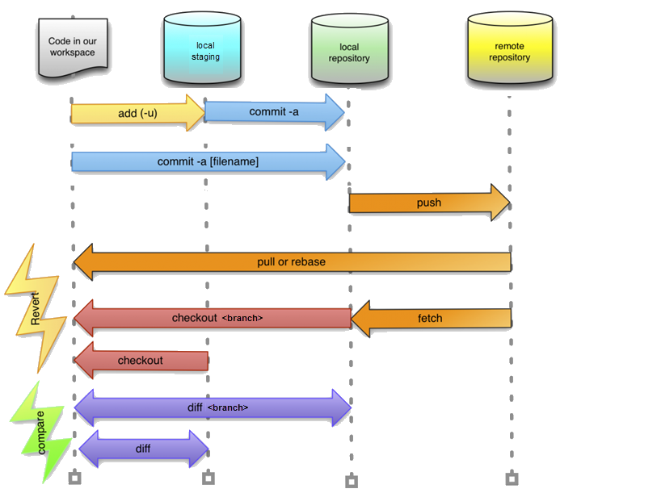
Notes:
git init
git status
git add
(to delete a file from Git, delete it locally, then do git add <file> then git commit
gitk – open git log browser
git commit –m “message”
git branch
git branch <name>
git branch –d <name> // delete branch
HEAD points to a branch, branch points to the commit
branch points to a commit
add git --cached

Slide 15
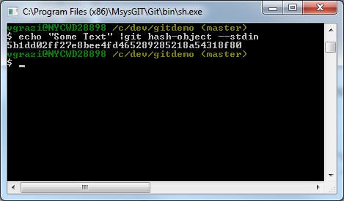
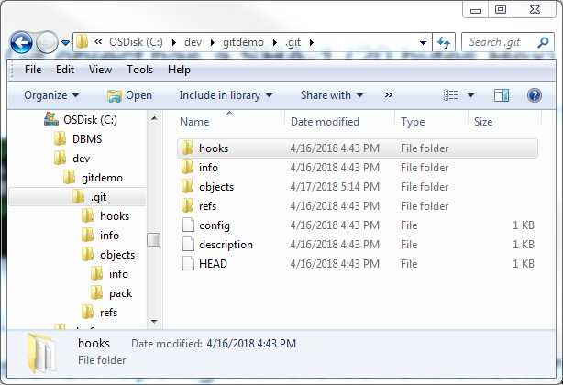
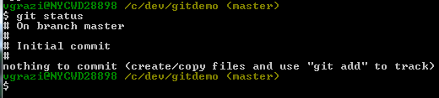
Digging in
Every Git object has a SHA-1 (20 bytes Hex)
echo “Some text” | git hash-object –stdin
git init - creates a Git repo
right in the current directory:
git cat-file -p <sha-1> Displays the object content
git status

Slide 16
Digging in
Every Git object has a SHA-1 (20 bytes Hex)
echo “Some text” | git hash-object –stdin
git init - creates a Git repo
right in the current directory:
git cat-file -p <sha-1> Displays the object content

Slide 17
Digging in
git status

Slide 18
What is a commit?
021e638 Oct 19 12:51 Victor Grazi: done!
HEAD
bf1599d Oct 17 12:49 John Jones: almost..
HEAD
a641e01 Sep 15 12:46 John Jones : more stuff
HEAD
9aca92f Aug 21 12:42 Victor Grazi: some stuff
HEAD
6e33d1c Aug 17 12:21 John Jones: modified
HEAD
fed59d6 Jul 17 11:45 Victor Grazi: initial
HEAD

Slide 19
What is a branch?
fe1632
HEAD
932f60a
HEAD
021e638
HEAD
a641e01
HEAD
3f1509d
HEAD
bf1599d
HEAD
9aca92f
HEAD
6e33d1c
HEAD
de159d6
HEAD
my-branch
master
other-branch

Slide 20
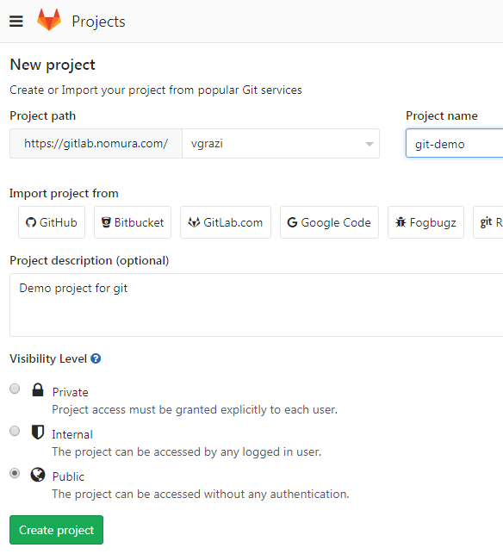

Recommend using Git Bash, installed as part of the Git installation
If you like Unix commands, this provides a highly usable unix Bash shell in Windows
To create a new project in Gitlab:

Slide 21
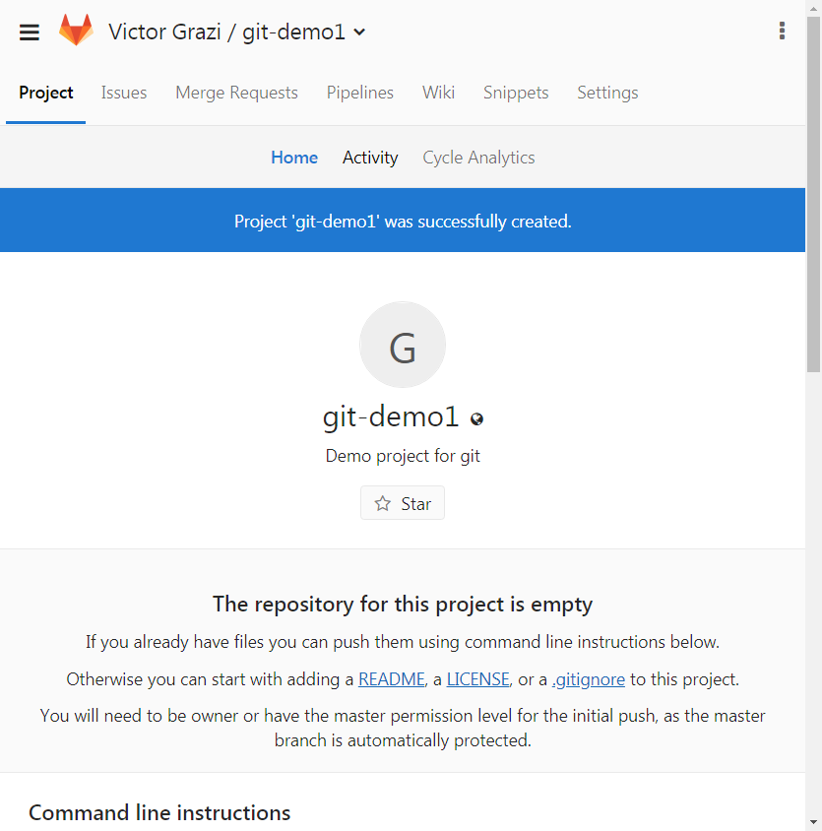
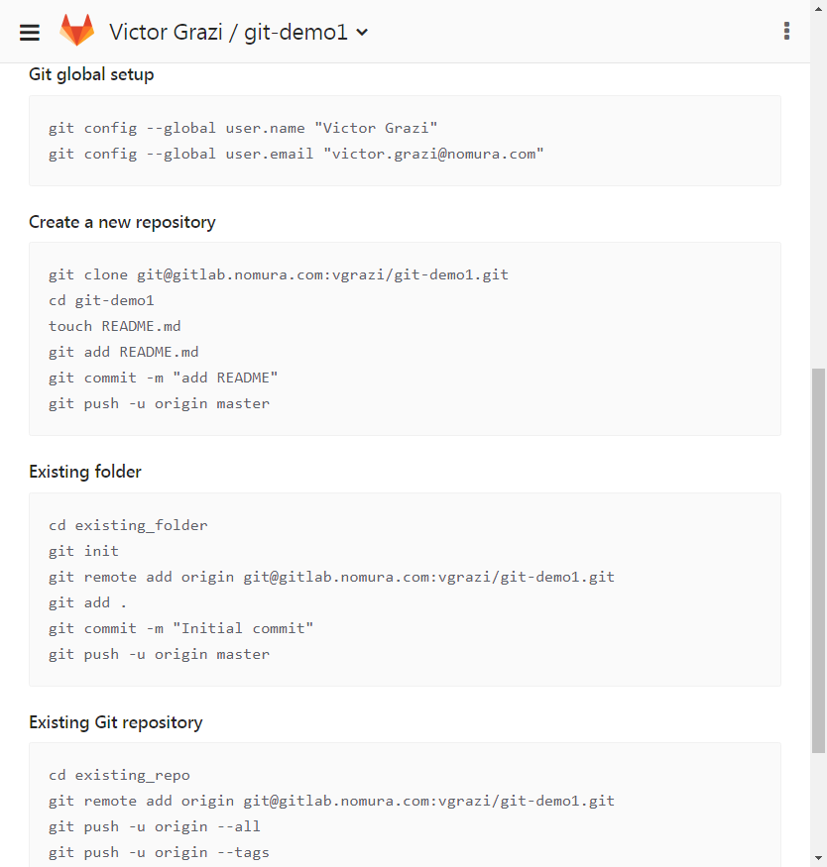

Slide 22
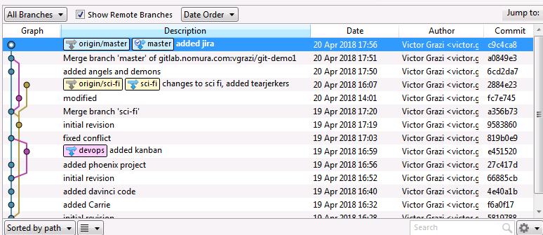
Git –
Notes:
Once you do an init, you can start versioning anything under that directory. No need for a remote

Slide 23
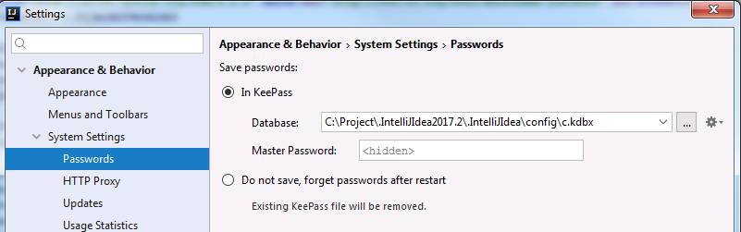

Slide 24

git ignore
IntelliJ
FMI https://www.jetbrains.com/help/idea/using-git-integration.html
Local changes (Alt-9)
In file markers:
Ctrl-A Annotate – click to show files in the commit, click to show diffs
Ctrl-Shift-Alt Down/Up arrow to navigate to next/previous change
View/ Restore changed lines
Ctrl-K Stage area
Ctrl-T
log
cherry pick
stash/
squash
reset
revert

Slide 25
More information
Git documentation: https://git-scm.com/doc

